Slide 1
YouTube Data Analysis in Hadoop MapReduce Environment
INFERNO
Arpit Mathur
Senthamil Sindhu
Vimarsh Deo

Slide 2
Group project Description
YouTube allows billions of people to connect, inform, and inspire others across the globe using originally created videos.
In our Project we analyze the data to identify the top 5 categories in which the most number of videos are uploaded.
The dataset will be gathered using the YouTube API and stored in Hadoop Distributed File System(HDFS)
MapReduce algorithm will be applied to process the dataset and identify the video categories.

Slide 3
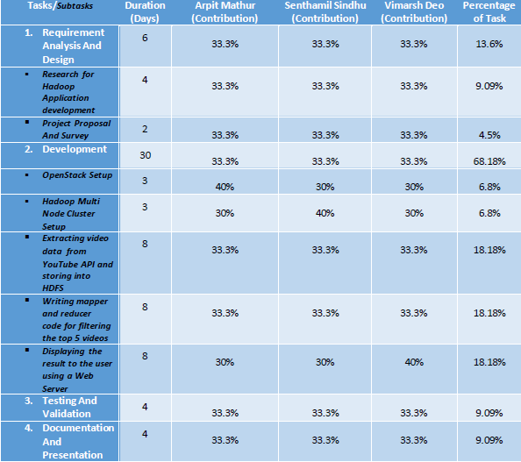
Project Description (cont.)
Tasks allocation

Slide 4
Technical Details
Software
  YouTube API
  Apache Hadoop 2.0
  Java, PIG, HIVE, HTML, CSS
  Ubuntu 16.04 LTS
Hardware
  Thoth Lab Infrastructure

Slide 5
Technical Details
Project Setup

Slide 6
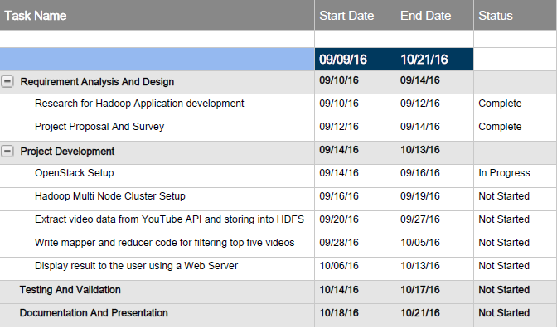
Technical Details
Project Milestones

Slide 7
Risks and Benefits
Novel aspects of this project:
  This application can help YouTube understand the top most trending topics.
  Test and classify videos on real time data.
Risks/challenges:
  Crawling large amount of datasets using YouTube API on various search queries.
  Setting up Hadoop cluster with Openstack.
Potential applications & benefits:
  Transforming these data into decisions which has good impact on the real world.
  Develop a scheduler to crawl the data every week and analyze the data to show week wise hot topics.

Slide 8
Tasks Accomplished by Now
Project Proposal completed.
Finished setting up multi-node Hadoop Cluster in VMs.
Collected data from YouTube API
Implemented mapper and reducer code to handle the top 5 categories and the uploaders count.
Project Link: http://gitlab.thothlab.org/amathu18/YouTube-Data-Analysis.git

Slide 9
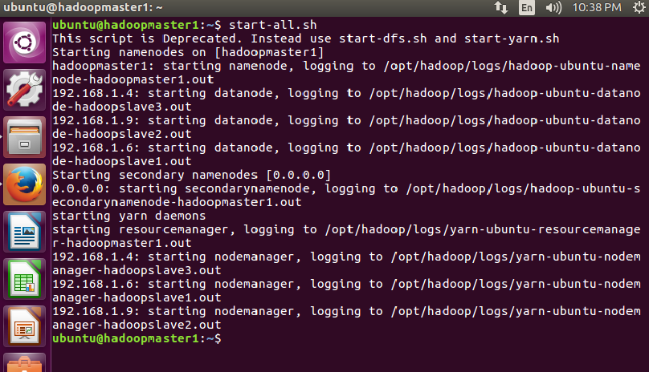
Hadoop multinode cluster setup
The cluster is setup by downloading and installing Hadoop 2.6.0
start-all.sh - used to run all the daemons

Slide 10
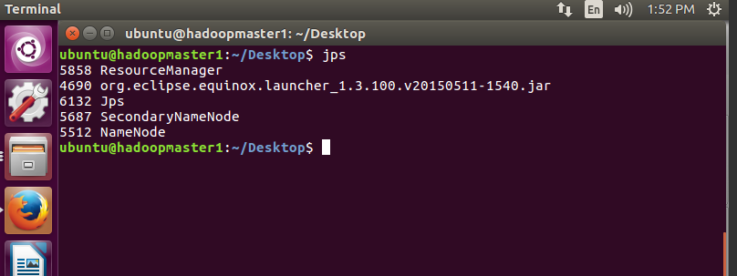
Hadoop multinode cluster setup
jps – used to check the status of the nodes running
Below figure shows the namenode running

Slide 11
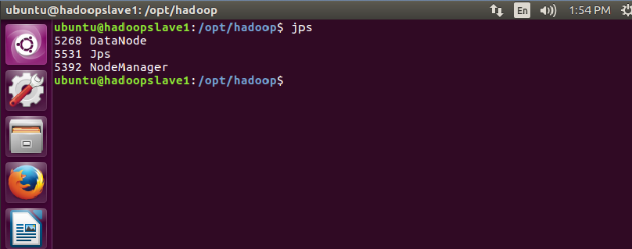
Hadoop multinode cluster setup
Below figure shows the datanode running in the slave 1

Slide 12
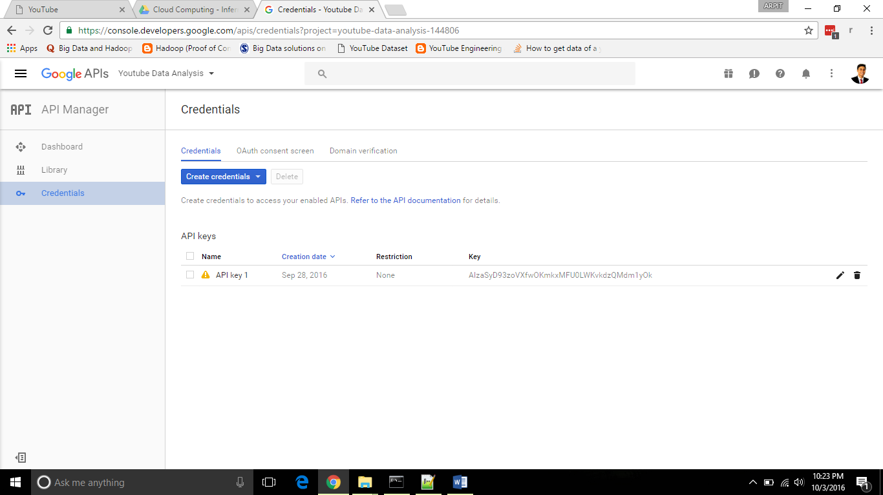
Data extraction from YouTube API
Step 1: Google account registration – to get the API key

Slide 13
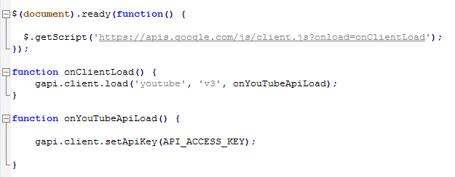
Data extraction from YouTube API
Step 2: Communicate with the API using the access key

Slide 14
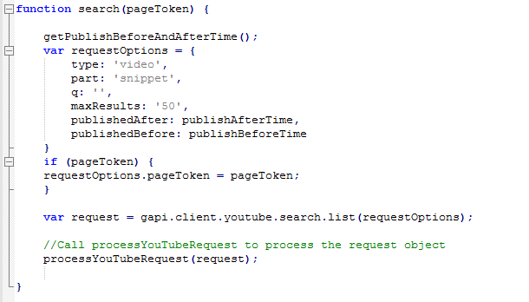
Data extraction from YouTube API
Step 3: Feed the search query with user
data

Slide 15
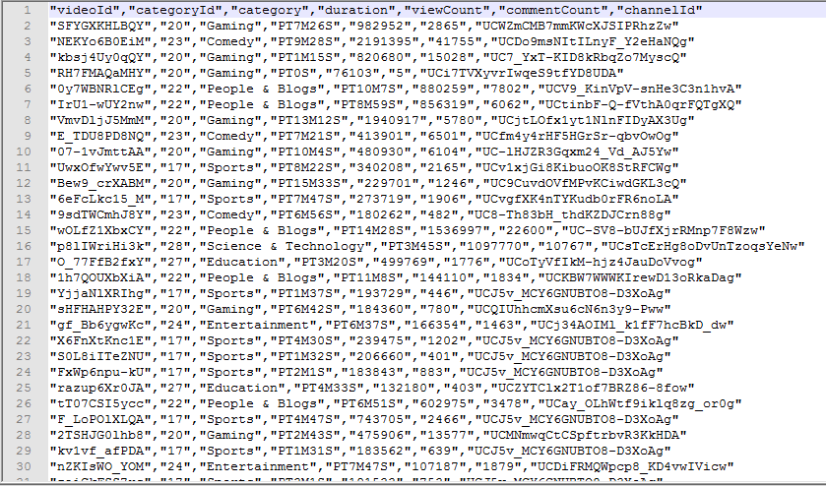
Data extraction from YouTube API
Step 4: Data sent to server & stored in CSV format

Slide 16
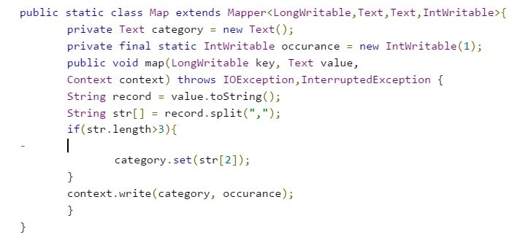
Implementing MapReduce
Mapper code for storing the categories:

Slide 17
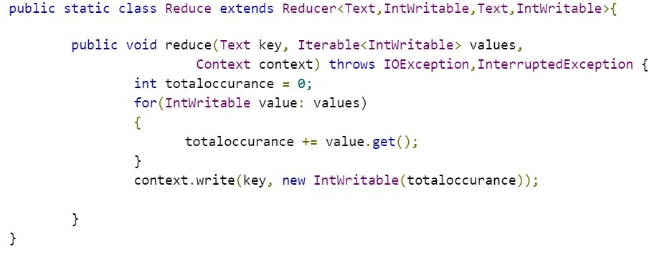
Implementing MapReduce
Reducer code – performs summary operation to collect the categories with number of videos

Slide 18
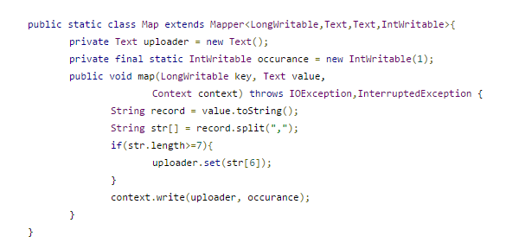
Implementing MapReduce
Mapper code for storing the uploaders

Slide 19
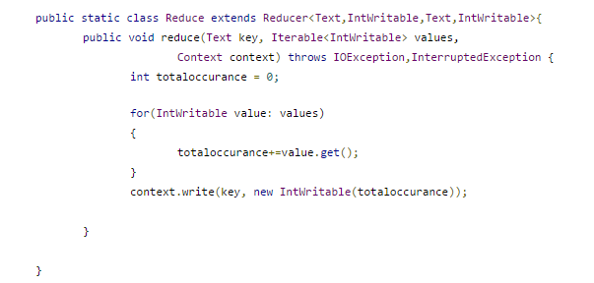
Implementing MapReduce
Reducer code – performs summary operation to collect the uploaders with the number of videos

Slide 20
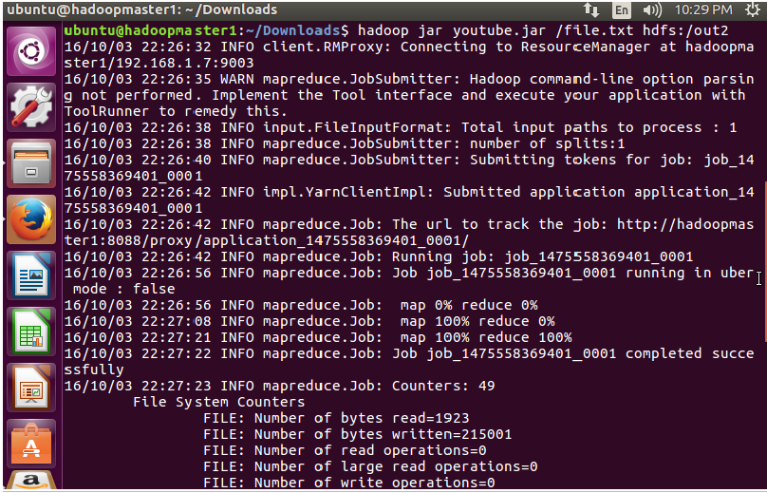
Execution
Running the MapReduce job:

Slide 21
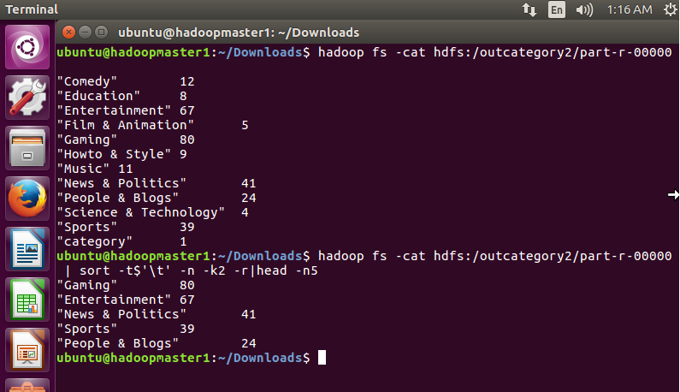
Results
Output 1 - Sort command used to display the top 5 categories.

Slide 22
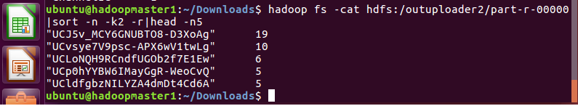
Results
Output 2 – Sort command used to display the top 5 uploaders

Slide 23
Conclusion
This project enables us to analyze trending topics and interests of people through social networking forum.
We have done data analysis on a single YouTube dataset. Future work can be done by doing the same analysis on weekly gathered data to identify the current trending topics and area of interest of the mass.
Future work also includes transforming these data into decisions which has good impact on the real world.

Slide 24
Thank You

